Slide 1
Introduction to Programming(II) Week 06
李哲榮

Slide 2
Computer System
Application Programs
Your code
Libraries
Software
Operating System
Drivers
Scheduler
Memory
Manager
Instruction Set Architecture
Execution Hardware (CPU)
Memory
Translation
System Interconnect
(Bus)
Hardware
Controllers
Controllers
I/O Devices
Networking
Main
Memory

Slide 3
software
Application Programs
Libraries
Software
Operating System
Drivers
Scheduler
Memory
Manager
Instruction Set Architecture
Execution Hardware (CPU)
Memory
Translation
System Interconnect
(Bus)
Hardware
Controllers
Controllers
I/O Devices
Networking
Main
Memory

Slide 4
Your Code
int input;
scanf(“%d”, &input);
if (input%2 == 0 )
printf(“%d is even\n”);
else
printf(“%d is odd\n”);
Functions in the standard C library

Slide 5
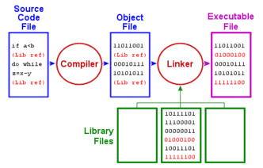
Compiler and Linker
Your code will be compiled to an object file first

Slide 6
Loader
Code can only be executed in the memory.
Loader is a system software that loads executable files from disk into memory (RAM) so that CPU can run the processes in RAM.
Hard Disk
Memory
Read file to RAM
Code
Data
Allocate a memory space
Open
OS
a.exe
Loader

Slide 7
Bootloader
The bootloader loads OS when a computer is turned on.
https://neosmart.net/wiki/mbr-boot-process/
BIOS/UEFI
(ROM)
Bootloader
OS
Firmware on
motherboard
Software on disk
Notes:
Unified Extensible Firmware Interface，縮寫UEFI

Slide 8
What does OS do?
Resource abstraction:
Ex: files (disk block), (input/output) device driver…
Resource management:
Four major tasks
User Interface
Process (CPU)
Memory (RAM)
Files (Disks)
Input/output (Devices)

Slide 9
Process Management
A single CPU can be used to run multiple processes (feel like) simultaneously.
0ms 50ms 150ms 250ms 350ms
Interrupt
Interrupt
Interrupt
Interrupt
Process A
Process switch
Process B
Process switch
Process A
Process switch
Process B
Process switch
Process B ready
Process A ready
Process B ready
Timeslice

Slide 10
Memory Management
Handle the requests of malloc and free
Example:
A = malloc(4)
B = malloc(5)
C = malloc(3)
free(B)
D = malloc(4)
E = malloc(2)
free (C)
F = malloc(4)
https://www.ibm.com/developerworks/linux/library/l-memory/

Slide 11
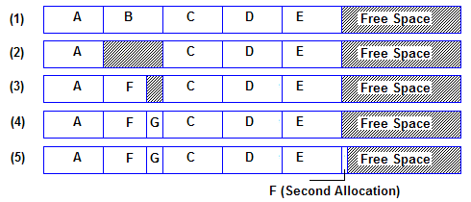
File System
Controls how data is stored in and retrieved from disks
Example (from wikipedia)
https://upload.wikimedia.org/wikipedia/commons/9/99/File_system_fragmentation.png

Slide 12
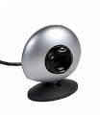
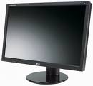
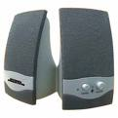
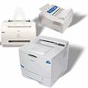
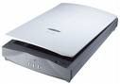

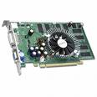
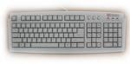
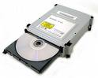
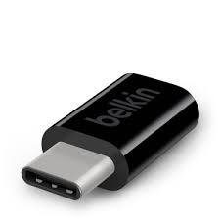
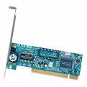
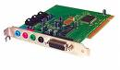
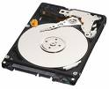
IO Management
Handle the input/output of all devices
顯示卡
音效卡
網路卡

Slide 13
Instruction set architecture
Application Programs
Libraries
Software
Operating System
Drivers
Scheduler
Memory
Manager
Instruction Set Architecture
Execution Hardware (CPU)
Memory
Translation
System Interconnect
(Bus)
Hardware
Controllers
Controllers
I/O Devices
Networking
Main
Memory

Slide 14
What is an assembly code?
Consider the language translation from Chinese to English?
Analogy
C code
Assembly code
Machine code
一個程式是如何被執行?
如何 是 一個 程式 被執行?
How is a program executed?

Slide 15
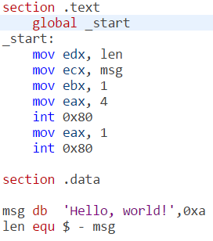
Why assembly?
C codes (or any high level programs) are very different from the machine code
01101001001001001101010101010010100101010101010101101010101011101101010101110010101010101011010110...
#include <stdio.h>
int main(){
printf(“Hello World!”);
return 0; }
Answers:
Human readable
One to one to machine code

Slide 16
Hardware Level
Hard disk
(硬碟)
Mother board (主機板)
CPU (中央處理器)
Registers
(暫存器)
ALU
(計算邏輯單元)
Memory (記憶體)

Slide 17

How is a program executed?
Hard disk
(硬碟)
Mother board (主機板)
CPU (中央處理器)
HelloWorld.c
Registers
(暫存器)
ALU
(計算邏輯單元)
Compiler
Assembly code
Memory (記憶體)
Assembler
Machine code
(Executable)
Machine code
(Executable)

Slide 18
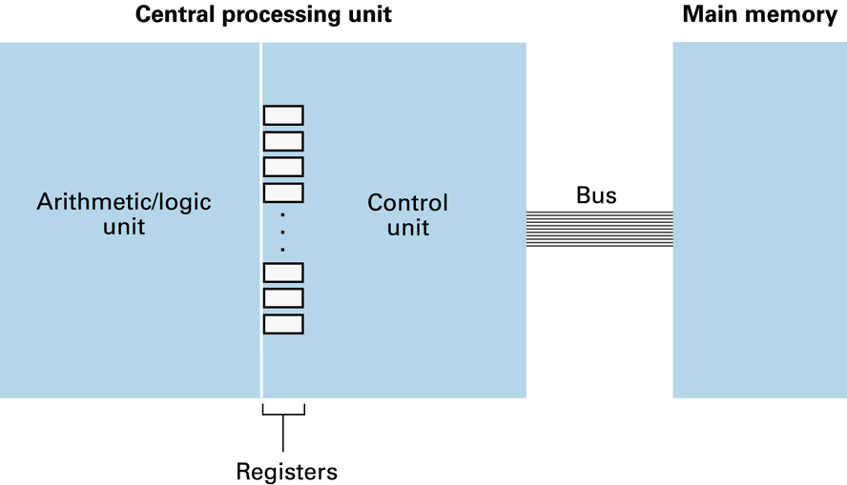
Machine code
A machine code is a sequence of “instructions”.
The basic unit of machine codes is an “instruction”.
Example: a = b + c;
mov [21] to r1
mov [63] to r10
add r1, r10, r5
mov r5 to [D8]
1
1+2
3
2

Slide 19
Discrimination
Name | Example | Meaning
Variable | a, b, c | The high level naming of memory space.
Value | 1, 2, 3 | The value stored in the memory space.
Memory address | [21],[63], [D8] | The address of memory where data are stored.
Register | r1, r5, r10 | Temporary storage of data inside CPU.

Slide 20
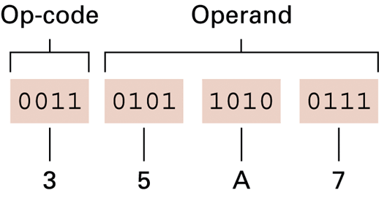
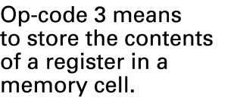
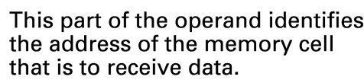
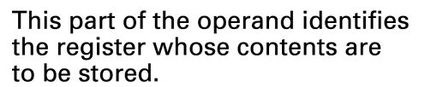
Instruction format
Instructions are encoded in binary numbers.
Ex:
Op-code: Specifies which operation to execute
Operand: Gives more detailed information about the operation

Slide 21
Instruction types
Data Transfer
Copy data between CPU and memory/devices
E.g., LOAD, STORE, device I/O,
Control
Direct the execution of the program
E.g., JUMP, BRANCH, JNE (conditional jump),
Arithmetic/Logic
Use existing data values to compute a new value
E.g., AND, OR, XOR, SHIFT, ROTATE, etc.

Slide 22
Instruction execution
Uses logic circuits
Data transfer: load, store, …
Logic circuit for registers (Ex: flip-flops)
Control: jump, jump-equal, …
Change the value of program counter (PC)
Comparison logic circuit
Arithmetic/Logic: add, and, shift, …
Again, logic circuits

Slide 23
User Mode/Kernel Mode
A computer usually has two modes for ISA:
Kernel mode (OS): can run any instructions
User mode (your code): can only run restricted instructions
Interrupts, exceptions, system calls
User Mode
Kernel Mode
Anytime OS wants

Slide 24
Hardware
Application Programs
Libraries
Software
Operating System
Drivers
Scheduler
Memory
Manager
Instruction Set Architecture
Execution Hardware (CPU)
Memory
Translation
System Interconnect
(Bus)
Hardware
Controllers
Controllers
I/O Devices
Networking
Main
Memory

Slide 25
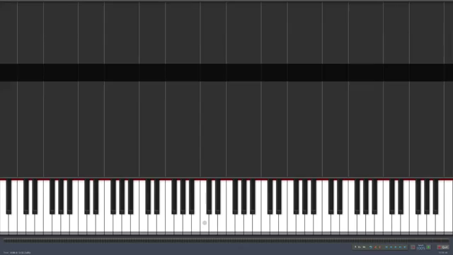
Music analogy
Applications |  | Music, songs
Pro-grams | C code | Scores (樂譜) | Staff (五線譜)
 | Assembly code |  | Tab (指譜)
Computer |  | Instrument (樂器)
Like different kinds of instruments have different tabs;
different kinds of computers (CPUs) have different instruction sets.
Death Waltz Synthesia
https://www.youtube.com/watch?v=O3Nc4iR7rGA

Slide 26
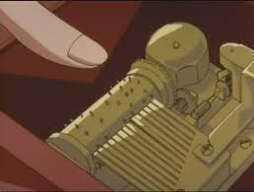
Who plays the music?
A computer is more like a music box, but the songs can be “programmed”.
Computer | Music box
1/0 | Touched /not
Electronic | Mechanic
Gates, circuits, … | Gears, screws,…
Program

Slide 27
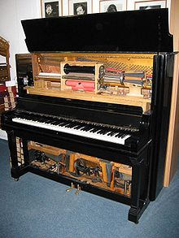
紙卷鋼琴 Reproducing Piano Rolls
一排65-88個「木手指」置於普通鋼琴鍵盤上方，代替了鋼琴家的雙手。演奏器以打孔紙卷（打孔位置與鋼琴譜相符）記譜，用腳踏風箱鼓風作為動力，通過紙卷緩緩轉動，紙卷上的孔位與驅動機械連動相應的「木手指」擊琴鍵奏出音樂。此後又有設計者將外附的演奏器直接安裝於鋼琴內部，還可控制速度、力度、踏板等。
https://zh.wikipedia.org/wiki/%E8%87%AA%E5%8B%95%E6%BC%94%E5%A5%8F%E9%8B%BC%E7%90%B4

Slide 28
AND gate
Inputs
Output
The AND Operation
0
AND 0
0
1
AND 0
0
0
AND 1
0
1
AND 1
1

Slide 29
OR gate
Inputs
Output
The OR Operation
0
OR 0
0
1
OR 0
1
0
OR 1
1
1
OR 1
1

Slide 30
XOR (eXclusive OR) gate
Inputs
Output
The OR Operation
0
XOR 0
0
1
XOR 0
1
0
XOR 1
1
1
XOR 1
0

Slide 31
NOT gate
Input
Output
The NOT Operation
NOT 0
1
NOT 1
0

Slide 32
Boolean operators
They are good for logic operations (bit operations), but how about arithmetic operations: +, -, *, /
Input |  | Output
A | B | A.and.B
0 | 0 | 0
0 | 1 | 0
1 | 0 | 0
1 | 1 | 1
Input |  | Output
A | B | A.or.B
0 | 0 | 0
0 | 1 | 1
1 | 0 | 1
1 | 1 | 1
Input |  | Output
A | B | A.xor.B
0 | 0 | 0
0 | 1 | 1
1 | 0 | 1
1 | 1 | 0
Input | Output
A | Not A
0 | 1
1 | 0

Slide 33
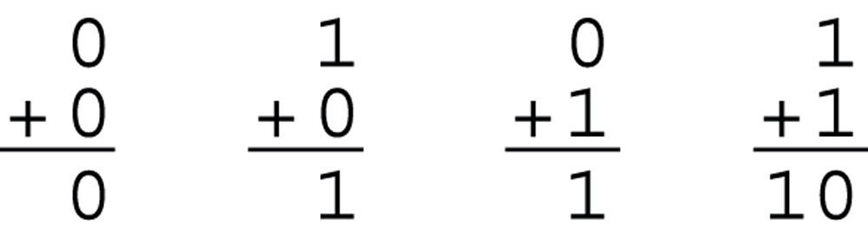
Boolean functions
Almost all binary operations of computers can be carried out by logic gates
Example: One bit adder
Two inputs and two outputs (S: sum, C: carry out)
A: input 1
B: input 2
S: output 1
C: output 2

Slide 34
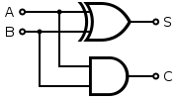
Implementation of one bit adder
The truth table of an one-bit adder
Compare it to the truth table of Boolean function AND, OR, XOR, NOT
S = A .XOR. B
C = A .AND. B
A | B | S | C
0 | 0 | 0 | 0
0 | 1 | 1 | 0
1 | 0 | 1 | 0
1 | 1 | 0 | 1

Slide 35
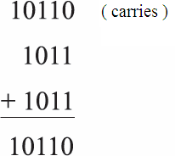
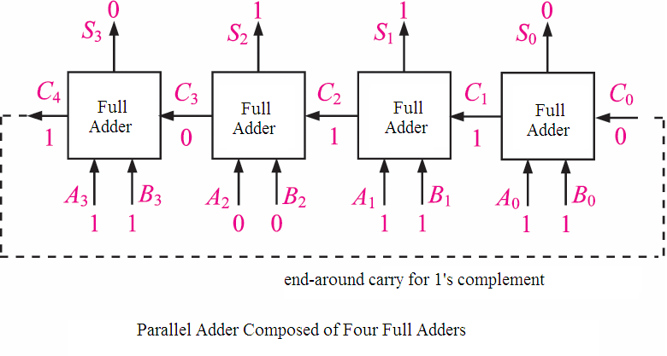
4 bit parallel adder

Slide 36
CPU
Control
Datapath
Memory
register
Memory
Controller
Control
signal
ALU
N
Z
clock
IR
PC

Slide 37
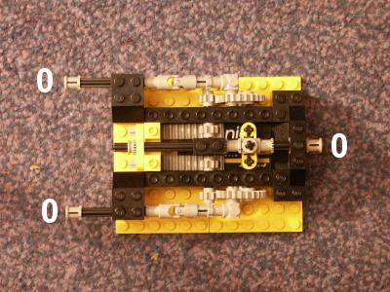
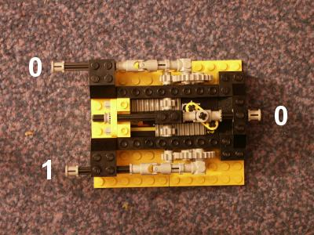
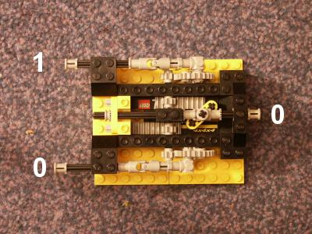
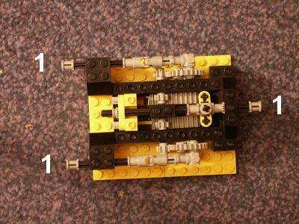
What can be a gate?
LEGO’s “mechanical gates”
The AND gate

Slide 38
Circuit gates
A
A
B
B
AND gate
OR gate
A
B
A
A
B
NOT gate
XOR gate
Can we flip the switches without hands?

Slide 39
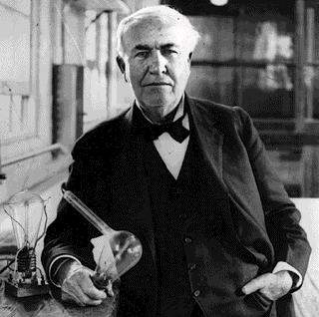
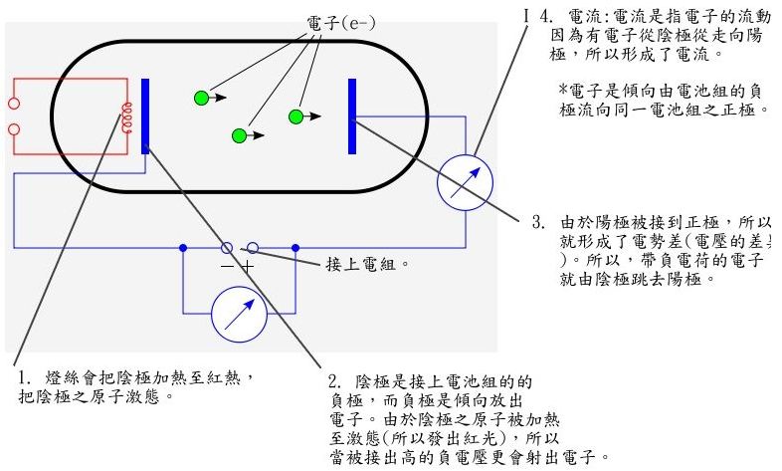
Electronic switch
The earliest one is the vacuum tube
1884, Thomas Edison

Slide 40
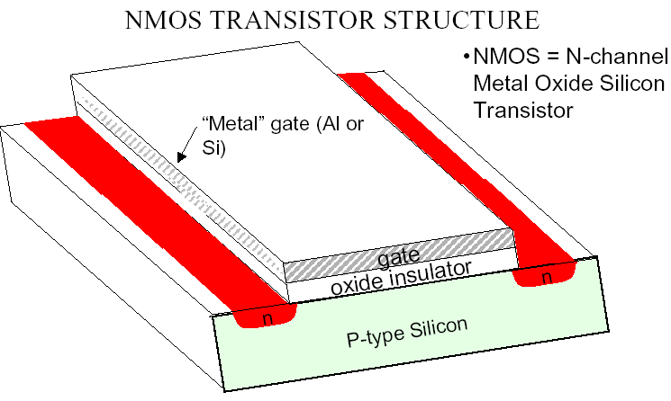
Transistor
The problems of vacuum tubes are slow, large, expensive, and easy to break.
Transistor can make it faster, smaller, and more robust.

Slide 41
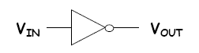
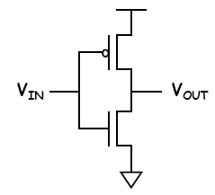
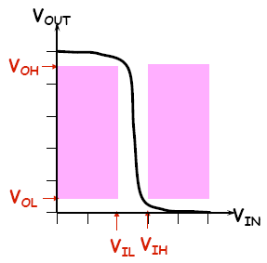
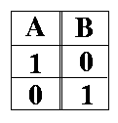
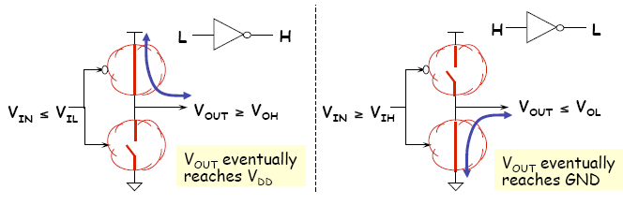
Transistors for logic gates
CMOS

Slide 42
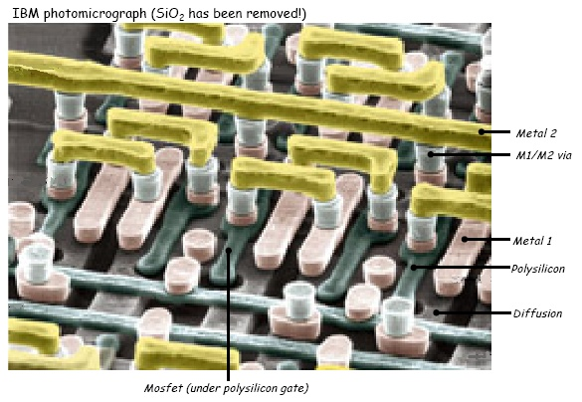
Integrated circuit (IC)
An electronic circuit consisted of transistors and other components in the thin substrate of semiconductor material.
Also known as IC, microchip, or chip.
Invented by Jack Kilby and Robert Noyce
2000 Nobel Prize in Physics
VLSI: Very-Large-Scale IC
More than million transistors

Slide 43
Discrimination
Name | Example | Meaning
Boolean operations | AND, OR, XOR, NOT | Math (logic) concept
Logic gate | AND gate, OR gate, XOR gate | Physical device implementing Boolean operations
Bitwise operators | &, |, ^, ~, >>, << | High level language syntax to process bits

Slide 44
Discrimination
Name | Example | Meaning
Boolean value | TRUE, FALSE | Math (logic) concept
Electronic signal | Ex: voltage high or low
Bit | 0,1 | Basic unit of data in computer system

